Slide 1

Enhancing Stock Market Modeling by Using GANs for Synthetic Data Creation
Ryan Shea

Slide 2
Synthetic Data for Financial Applications
Most commonly use Geometric Brownian Motions (GBMs) in a Monte Carlo (MC) simulation
Pro: Model the stochastic component well
Con: High bias regarding stock return structure

Slide 3
Idea: Train a Deep Learning Model to Generate Synthetic Returns
The model would learn the underlying structure of the model and have that in its synthesis
Can allow for better approximations of Conditional Value-at-Risk (CVaR) and other important risk metrics
Generate insights on the underlying structure of returns

Slide 4
Data Collection
Use python’s ‘yfinance’ package to scrape data from every stock in the S&P 500
01
Convert to log returns
02
This allows for ~50,000 5 day samples of real log returns
04
Sample 5 consecutive days randomly 100 times for each stock
03

Slide 5

Use GBMs as a Baseline
Generate 50,000 paths using GBM formula
Using a random mean and standard deviation from the real-returns dataset
Use a neutral model (LightGBM) as the discriminator
Allows for 0.779 accuracy in classification

Slide 6
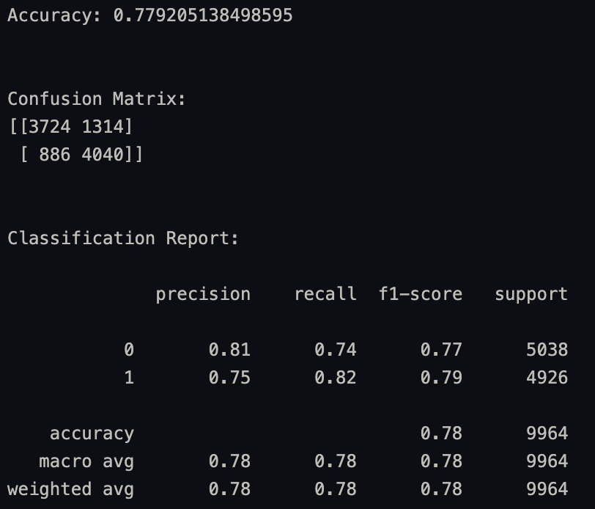
GBM Results

Slide 7
Generative Adversarial Networks (GANs)
2 Neural Networks
Generator: creates synthetic data with the same structure of the real data
Attempts to trick the other network into believing fake data is real, real is fake
Discriminator: discriminate between fake data and real
Easy to tell in the beginning but gets harder as the generator learns
The two networks work against each other, leading to more accurate data synthesis

Slide 8

Structure
Multi-layer Perceptron neural networks (MLPs) for both models
Serve as the simplest implementation, see for feasibility
Dropout layers for regularization, various activation functions and different hyperparameters
All implementation done in PyTorch
Source: PyTorch

Slide 9
Hyperparameters
Train size
Number of epochs
Batch size
Learning Rate
Adam optimizer B1 and B2
Clip Value
Implemented using a random search method for hyperparameter tuning

Slide 10
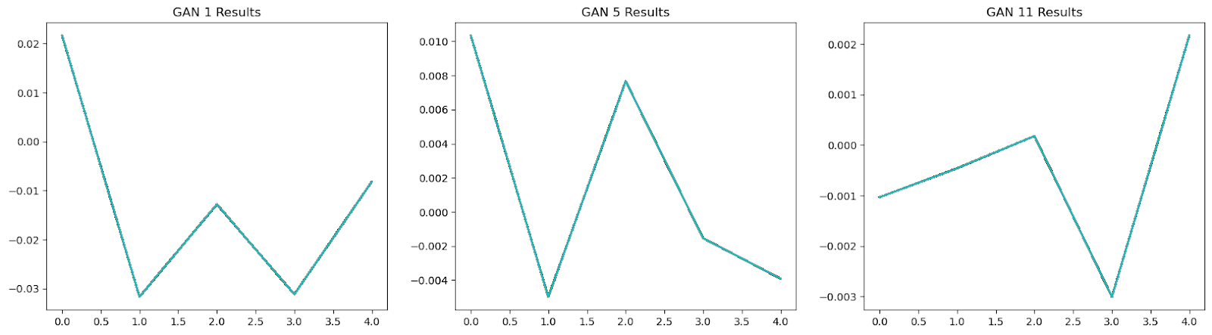
Results
13 different GANs total
Some have massive overfitting issues

Slide 11
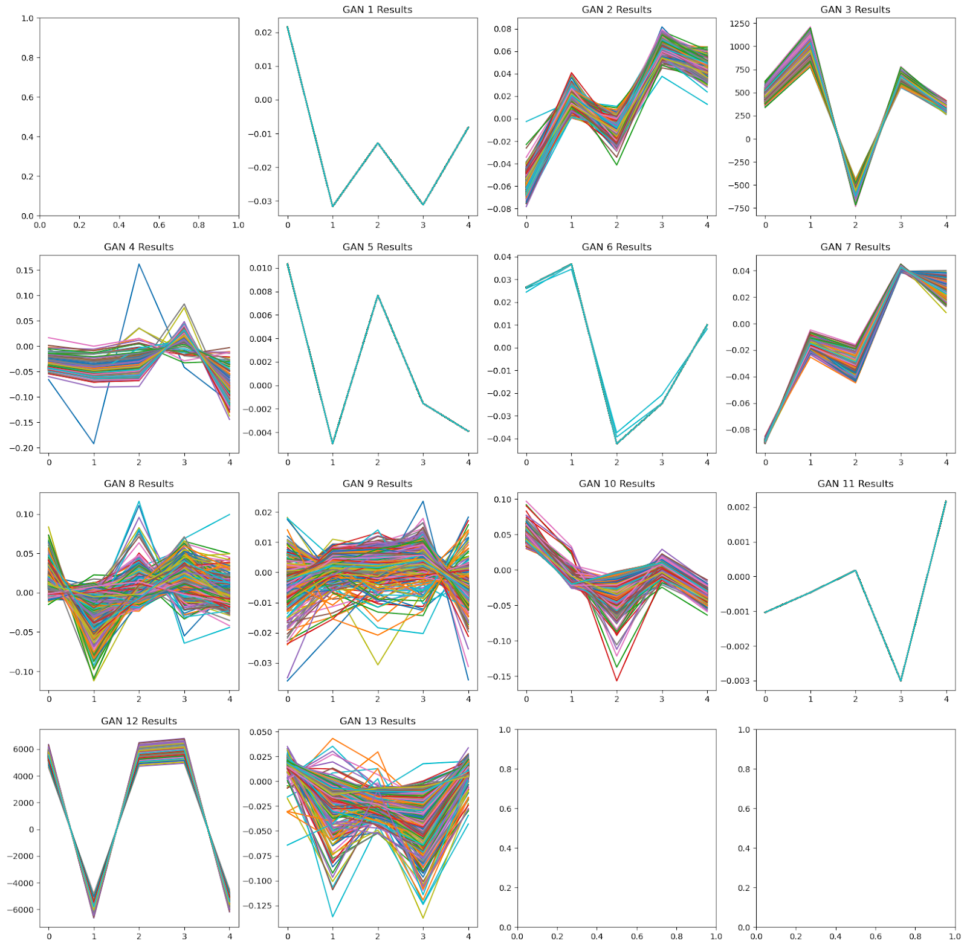
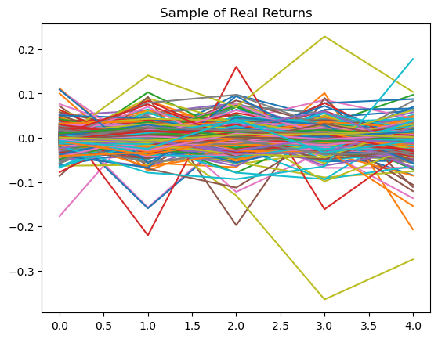
All Different Outputs

Slide 12
Visually, results are disappointing
Easy to tell what is real and what is fake (for the most part) visually
Now, compare to baseline, use LightGBM

Slide 13
Cross Validation Accuracy Score (20-fold CV)
 | GAN 1 | GAN 2 | GAN 3 | GAN 4 | GAN 5 | GAN 6 | GAN 7
mean | 0.9995 | 0.9975 | 1.0000 | 0.9900 | 0.9950 | 0.9985 | 1.0000
std | 0.0022 | 0.0054 | 0.0000 | 0.0089 | 0.0022 | 0.0036 | 0.0000
 | GAN 8 | GAN 9 | GAN 10 | GAN 11 | GAN 12 | GAN 13
mean | 0.9250 | 0.9660 | 0.9975 | 0.9995 | 1.0000 | 0.9865
std | 0.0309 | 0.0159 | 0.0043 | 0.0022 | 0.0000 | 0.0091
All perform significantly worse than GBM (0.779 accuracy)

Slide 14
Next Steps
Change structure with stronger regularization techniques
More aggressive dropout layers
Implement early stopping
Simplify the model
Pick ONE stock, not all in the S&P 500
Lead to fewer local minimums on the gradient
Pick a different type of Neural Network
Convolutional Neural Networks
Recurrent Neural Networks

Slide 15
Next Steps (cont.)
Add more inputs
Open – Close
Volume
More efficient Hyperparameter Tuning
Bayesian Optimization
Run current model more, possible to get a better model
GAN 8 had CV accuracy of 0.925
Possible to beat GBM benchmark of 0.779 with luck

Slide 16
Thank You!
Source code
Questions?

